Slide 1

Strategic Talent Management Training
HRO Today Training 5-3-21
V1.0

Slide 2
What is Strategic Talent Management?
A process that an organization participates in to source, attract, select, train, develop, retain, and move employees through the organization.
Talent Management is an evolving business science
It is a new age system of turning the HR department into a strategic business unit
Notes:
Talent management is a way of transforming the HR department from a tactical group dealing with compensation & benefits, payroll, legal, etc. , into a strategic business unit that can directly effect the companies’ bottom line. The people in your company are your largest asset, and can account for vast amounts of money saved or lost depending on how effectively you manage them.

Slide 3
The Evolution of
Strategic Talent Management
The Industrial Age – focus on manufacturing, people considered a cost
The Knowledge Age – service-oriented economy, people viewed as potential assets
The Talent Age – where we are now. Agility, response time to change, innovation, people are the most valued asset
Notes:
The industrial age was when the economy was manufacturing oriented (auto industry, assembly lines, steel stamping, etc). Decisions in this age were generally made by just a few people in each company, command and control was vital to the business’s success, and employees were easily replaceable like machine parts. People were considered a cost to be controlled.
The knowledge age came about as the economy became more service oriented (travel and hospitality, technology boom – silicon valley, the need for engineers and actual brain power). Decision making began to be pushed down the organization to more people. People were beginning to be viewed as potential assets.
Recently, we have reached a Talent age. A successful company must be innovative, agile; the need to respond quickly and effectively to rapid change is a must, as well as the companies ability to award the best idea, and to encourage creativity. The different business silos need to be broken down so that communication is happening across all business units, and the effective management of the people within an organization will directly effect the companies success and profitability.

Slide 4
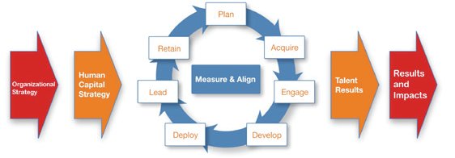
The Talent Life Cycle
Notes:
The strategy of the business, or “organizational strategy”, needs to directly align with your Talent strategy, or “human capital strategy” on this slide. In the center we have “the talent lifecycle” which shows all of the different aspects or “verticals” within talent management. Along with the industry, TMA aligns its events based off of these talent verticals, as do companies base their different strategic HR roles or positions.
The idea behind the above visual is that once you begin doing each vertical effectively, you will see that the business results (bottom line) are directly effected by your talent results.
One piece which you will see on the next page that is missing from this page is the “evaluation” vertical. Effectively evaluating and tweaking your talent strategy is vital to its success.

Slide 5
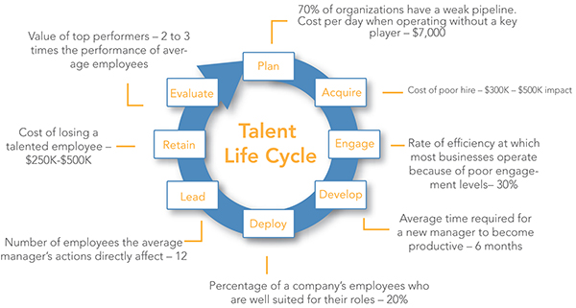
Notes:
All of these stats are based on large, fortune 500 sized organizations. The effects that these statements claim are still extremely significant for small businesses and mid sized organizations.

Slide 6
Workforce Planning
Define and Optimize a Workforce that can execute the organization’s business strategy, both today and in the future
Forecast supply and demand of talent needs followed by a strategy to close the gaps
Role segmentation, environmental scanning, current state analysis, futuring, gap analysis, action planning, monitoring and reporting
Notes:
Workforce Planning begins with the business strategy; you will notice that all the different talent verticals are based off of the business strategy, as each section needs to align correctly to work.
After defining what the business strategy is, an organization needs to segment the different roles by priority as it relates to the business strategy. Defining which roles will have the biggest impact on the organization is key so that the workforce plan can work effectively based off the priorities of the overall business goals.
Environmental scanning is making sure that you look at all facets of a problem or issue, both internal to your organization and externally. Seeing what competition is doing, economic trends, supply and demand of talent internally and externally, etc will help you make a more in depth and comprehensive plan.
Analyzing your current state is about defining what roles you have, then futuring gets into what roles you will need filled to accomplish your business goals. A good practice in futuring used today is to create 5+ targeted future states, which allows you to compensate for changes and be agile if things do not go as planned. Regardless of what turn the economy takes, as an organization you at least have some planning done regardless of what is thrown at you.
Analyzing and identifying where your talent gaps are, then action planning on how to fill them with the correct competencies and proceses allow for successful workforce plan implementation.
Finally, you must be able to monitor the effectiveness of the working workforce planning. These necessary measures and analytics are key to successfully sustaining your workforce planning model, as it will need constant tweaking and updating once initiated.

Slide 7
Talent Acquisition
The difference between Recruitment and Talent Acquisition lies in “attracting” talent
  Recruitment – Filling positions through profiling, finding (sourcing), assessing and hiring
  Talent Acquisition – the strategic value of attracting and hiring the RIGHT talent
Recruitment is tactical, Talent Acquisition is Strategic
Notes:
Recruiting tends to be very tactical whereas talent acquisition encompasses more than just “position filling”. Rather than hiring the most available people or the most experienced person for a position, talent acquisition aims to fill the position with the person that will best fit the role and strategic goals of the company. Things such as employment branding, sourcing through multiple mediums (social media, job boards, referrals, colleges, and 3rd party consultants), and the onboarding process are all aspects of Talent acquisition vs just recruiting talent.

Slide 8
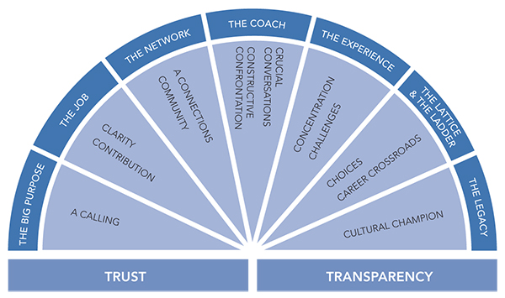
Engagement
The extent to which employees believe in what they do, feel valued for it and are willing to spend their intellectual effort to make the organization successful
Company Culture
Notes:
Engagement is crucial to productivity. Creating a company culture that fosters creativity and collaboration will increase productivity as well as become the main driver behind the retention of your employees. Your engagement practices must tailor its approach based off the individuals needs as well as the companies needs. Having a clear vision for the employee, making them aware of their contribution to the overall business, creating a network/community in the organization, having crucial conversations and constructive confrontations, setting challenging goals within an employees focus, creating choices for the employee to grow, and turning them into a cultural champion (someone that spreads the culture and engagement after mastering their position).

Slide 9
Development & Deployment
Most companies spend their time identifying talent rather than developing it
Development programs increase productivity and engagement, and decrease the likelihood that an employee will leave or seek another opportunity
Deploying (or redeploying) your talent into the right role will save money, and increase productivity and efficiency
Notes:
Development programs continually increase the employees’ skillset, making them more valuable to you (the employer) as well as to themselves. The majority of development should mostly occur through difficult assignments on the job (experiential learning), followed by connecting with others (social media, forums, and in person) through feedback, observation, coaches and mentors. Last but not least, development should also occur through training and self study outside of work. Keeping an employee out of their comfort zone, but not in a state of panic is optimal for continual learning.
Deploying talent is key to your operating efficiency as an employer as well as your employees happiness and engagement. Sometimes this means taking someone from a role they thought they could succeed at, and redeploying them into a better fit. This redeployment vs firing and hiring new talent saves lots of money not only on the actual position salary, but in training hours and dollars.

Slide 10
Leadership
High Potentials
Identifying Talent
Key Skills: Courage, vision, inspiring followers, serving, advocacy, decision making, entrepreneurship
Notes:
Harvard Business Review Definition: “High Potentials consistently and significantly outperform their peer groups in a variety of settings and circumstances. While achieving these superior levels of performance, they exhibit behaviors that reflect their companies’ culture and values in an exemplary manner. Moreover, they show a strong capacity to grow and succeed throughout their careers within an organization – more quickly and effectively than their peer groups do.”
High performers are not necessarily high potentials as they may not be suited to actually leading. Most managers get put into their roles for being high performers, yet they only possess individual contributor skills vs actual management and leadership ability.
Succession planning and bench strength is a key part of leadership development within HR as you must have people ready to step up that possess the skills to take over a keystone position. Without a strong bench for these key roles, a company can get caught out and have to spend massive amounts of $$ for recovery from losing a key employee.

Slide 11
Retention
How to keep your employees
Using engagement as your biggest driver of retention
Recognizing the stages
Notes:
Looking at Behavior Measures – Participation in Company events, sick time/personal days, participation in employee referral programs, internal job applications and movement
Manager engagement is leading source of employee engagement and retention. Most reasons for leaving a company are: poor relationship with manager, lack of opportunity to grow and develop, and lack of challenging and meaningful work
Employee Empowerment (look this up)…accountability and ownership of role. Also add in section on recognizing the stages HERE
Retention really is the culmination of other talent practices.

Slide 12
Evaluation
Employers must constantly evaluate and report on how the talent practices are working and where improvements can be made
The ever-changing landscape
Notes:
It is key to be agile in strategic talent management. Technology and the global economy has changed the way we do business forever, and the only thing we can truly count on right now is change, rapid change. Evaluating talent practices every step of the way is key to successful alignment of your talent management to your business strategy and goals.

Slide 13
Conclusion
Strategic Talent Management is about turning HR into a centralized business unit that consistently gets the right people to fill each role within an organization.
Your clients live in this world and are constantly striving to get the buy in to DO these practices. Knowing what they deal with on a day to day and being able to speak with them from a position of knowledge will help you win their trust, and sell more of our products!
The more you learn, the better off you will be!

Slide 14
